Slide 1

Final Project – Heart Failure Analysis
Bhushan Suryawanshi
e-mail - bsuryawanshi@my365.bellevue.edu
Date: 2020-08-08
Reference -
1. Davide Chicco, Giuseppe Jurman: Machine learning can predict survival of patients with heart failure
from serum creatinine and ejection fraction alone. BMC Medical Informatics and Decision Making 20, 16 (2020).
(https://www.kaggle.com/andrewmvd/heart-failure-clinical-data )

Slide 2
Selected Variables
A minimum of 5 variables in your dataset used during your analysis (for help with selecting, the author made his selection on page 6 of your book). Consider what you think could have an impact on your question – remember this is never perfect, so don’t be worried if you miss one (Chapter 1).
Describe what the 5 variables mean in the dataset (Chapter 1).
I will be using "age", "ejection_fraction", "platelets", serum_sodium", "creatinine_phosphokinase" and "DEATH_EVEENT" for my analysis. I might use additional variables to check the effect of adding them. The reason I choose these variables because -
age - Age is showing quite a good variability in data from 40yrs to 95yrs of age. Majority of the time this age group is more prone to heart attack.
ejection_fraction - A normal ejection fraction is more than 55%. This means that 55% of the total blood in the left ventricle is pumped out with each heartbeat. Heart failure with reduced ejection fraction happens when the muscle of the left ventricle is not pumping as well as normal. The ejection fraction is 40% or less.
platelets - In cardiology, the most frequent cause of a low platelet count is an abnormal immune response caused by drug therapy, particularly with the intravenous blood thinner heparin (heparin-induced thrombocytopenia), and rarely with other drugs to control high blood pressure or symptoms of congestive heart failure.
serum_sodium - Hyponatremia or low serum sodium level is typically defined as a serum sodium concentration of <135 mEq/L and is one of the most common biochemical disorders featured in heart failure patients
creatinine_phosphokinase - Creatine phosphokinase (a.k.a., creatine kinase, CPK, or CK) is an enzyme . Person's CK-MB level is often checked when they exhibit signs of heart attack.
DEATH_EVEENT - It is binary variable showing if death happened (1) or not(0).

Slide 3
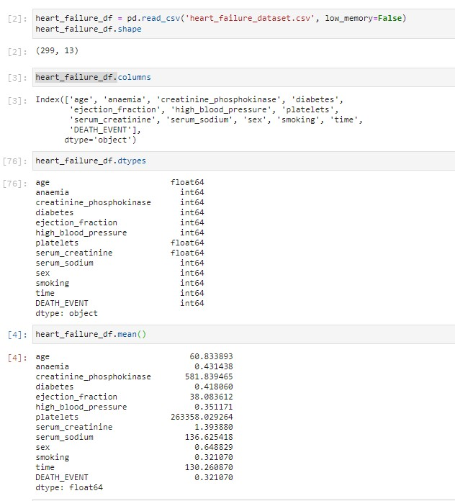
Selected Variables – continued...

Slide 4
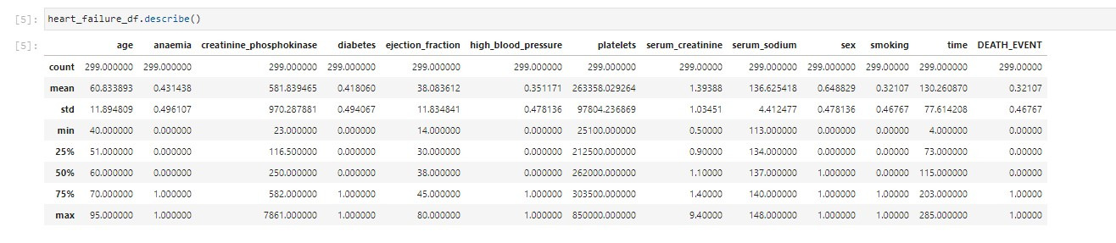
Selected Variables – continued...

Slide 5
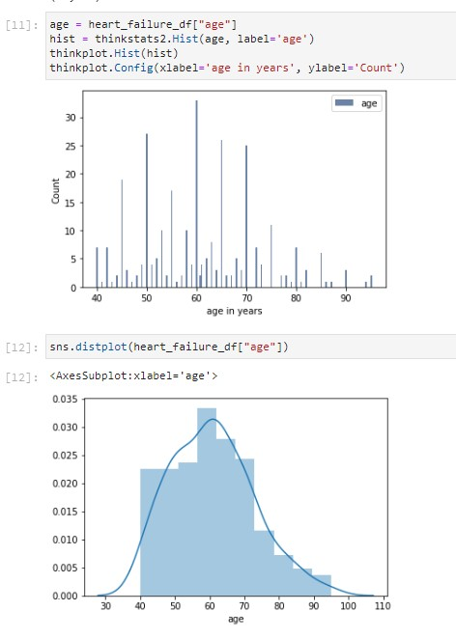
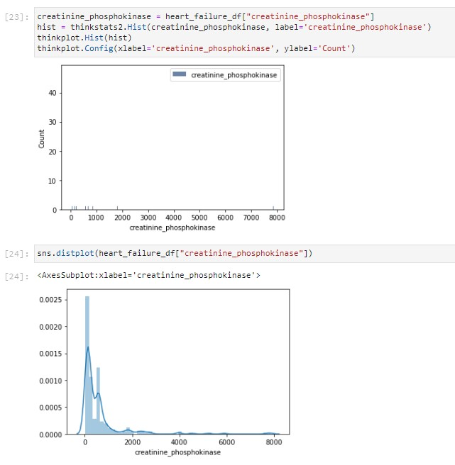
Histograms
Include a histogram of each of the 5 variables – in your summary and analysis, identify any outliers and
explain the reasoning for them being outliers and how you believe they should be handled (Chapter 2).

Slide 6
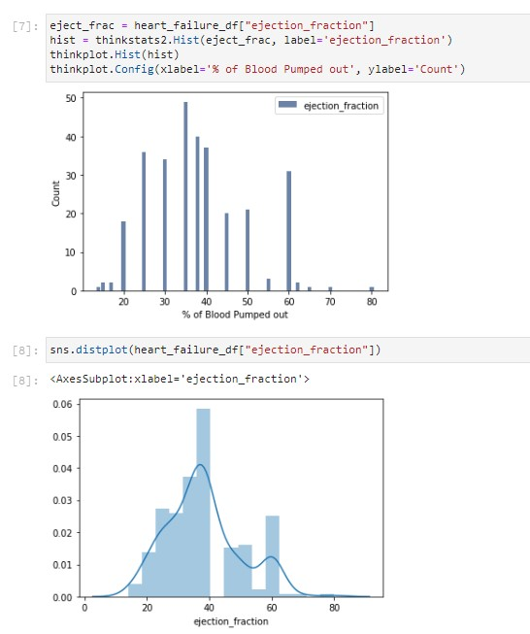
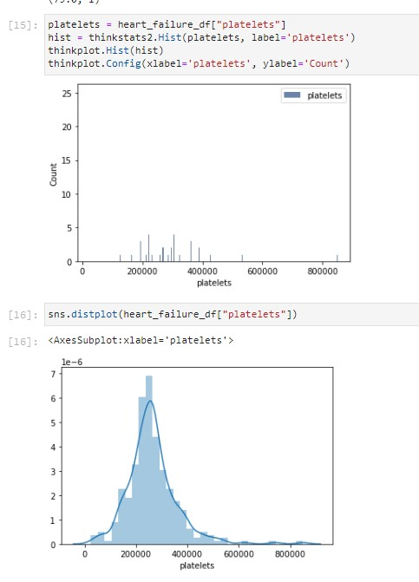
Histograms – continued...

Slide 7
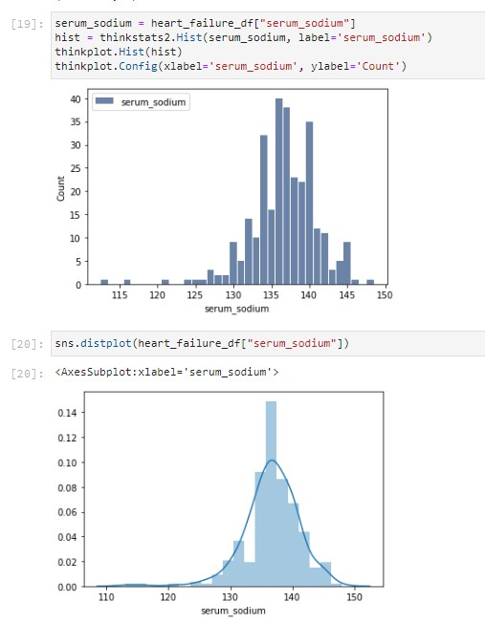
Histograms – continued...
I used thinkplot to get histograms but some of them are not quiet clear and didn’t find parameters to improve histogram visualization. Hence using seaborn distribution plot as well for better visualization of distribution. Also just as snapshot of all the data used pair plot to show scatterplot and histogram in one view on next slide.
Age histogram shows that most of the data lies between 40 and 80yrs of age. There are couple of outliers which have age of close to 95yrs.
Creatinine Phospokinase shows skewed distribution. However in my analysis I will be using ejection fraction and hence not doing anything to this data.
Ejection fraction shows approximately normal distribution with maximum data with ejection fraction below 40. There are couple of observation on each tail end with ejection fraction > 80 and <20.
Platelets looks normally distributed and 1 observation with more than 800K. Mode of the platelets is 300K.
Serum sodium histogram shows data skewed towards right. Most of the data has sodium levels of >130 and < 142.
Based on the histograms we can see most of the data lies between 95th percentile ranges. Hence not eliminating any data.

Slide 8
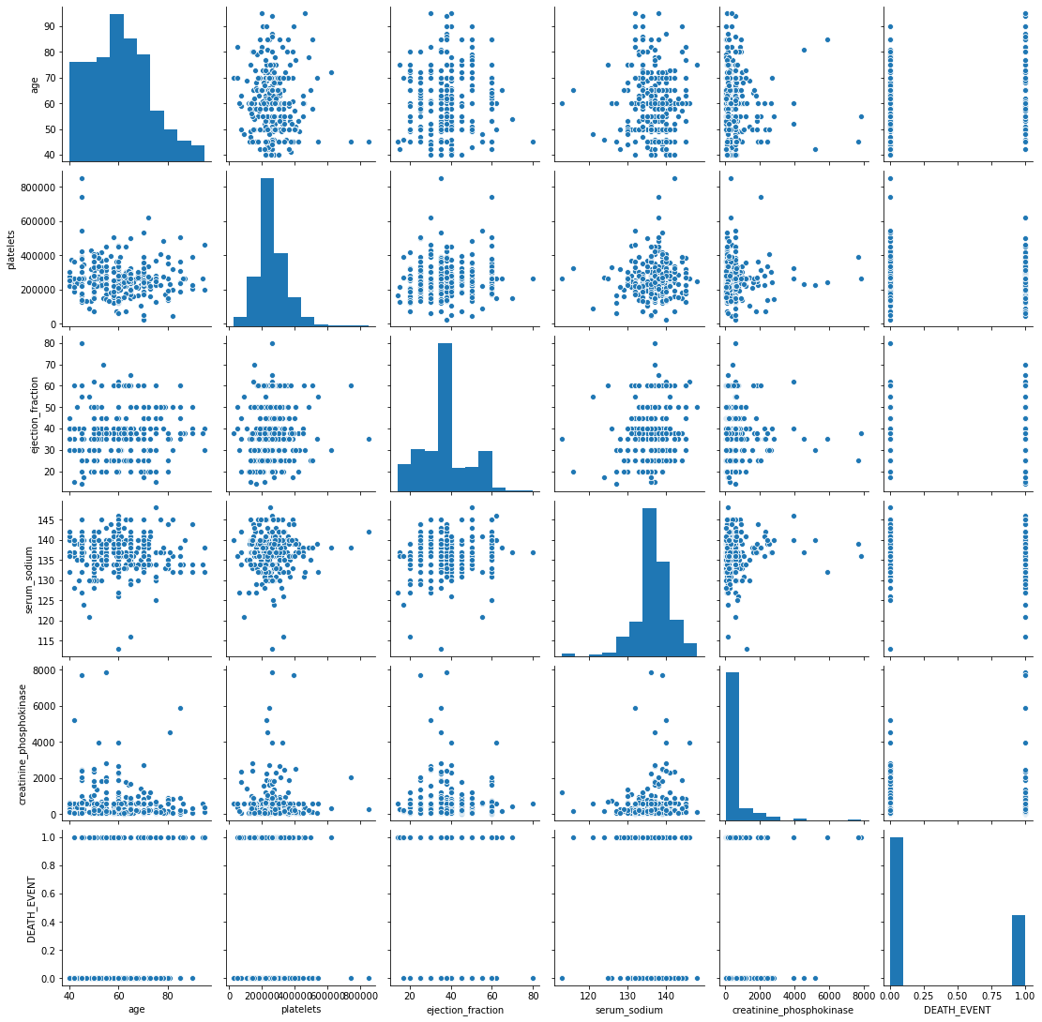
Histograms – continued...

Slide 9
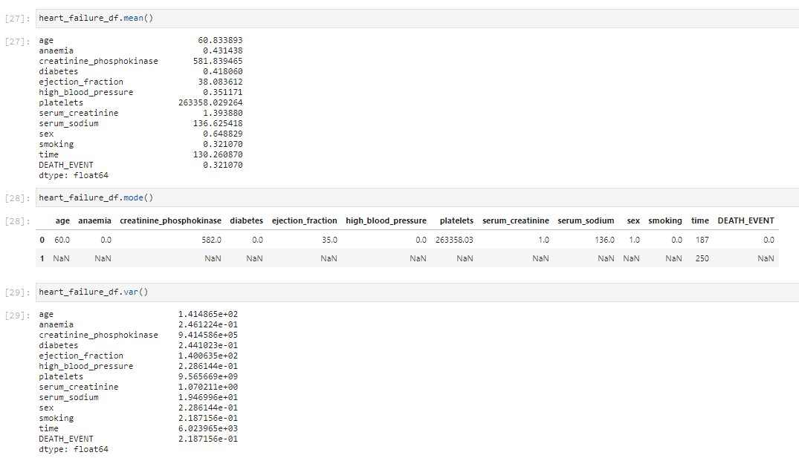
Descriptive Characteristics
Include the other descriptive characteristics about the variables: Mean, Mode, Spread, and Tails (Chapter 2).

Slide 10
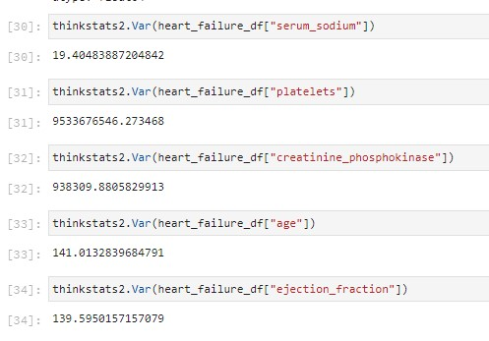
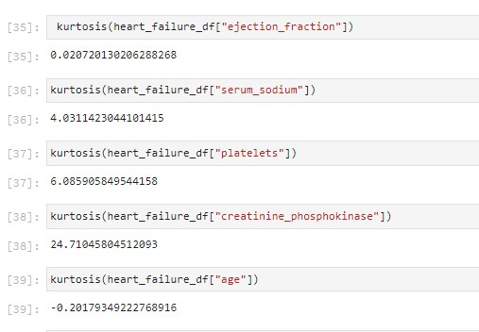
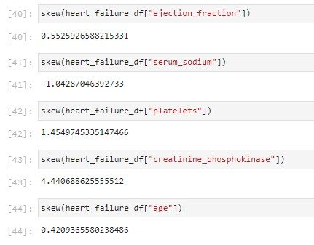
Descriptive Characteristics - continued...

Slide 11
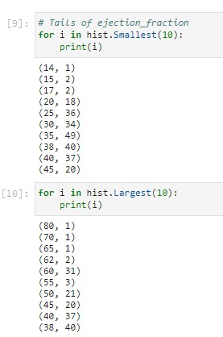
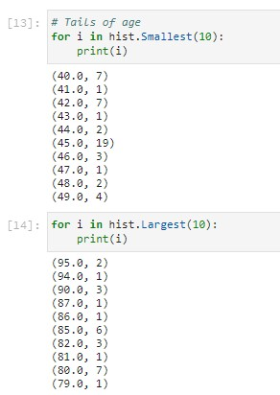
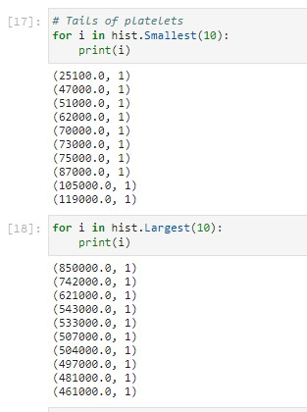
Descriptive Characteristics - continued...

Slide 12
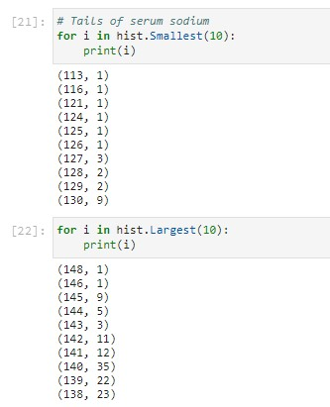
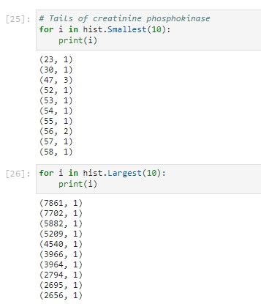
Descriptive Characteristics - continued...

Slide 13
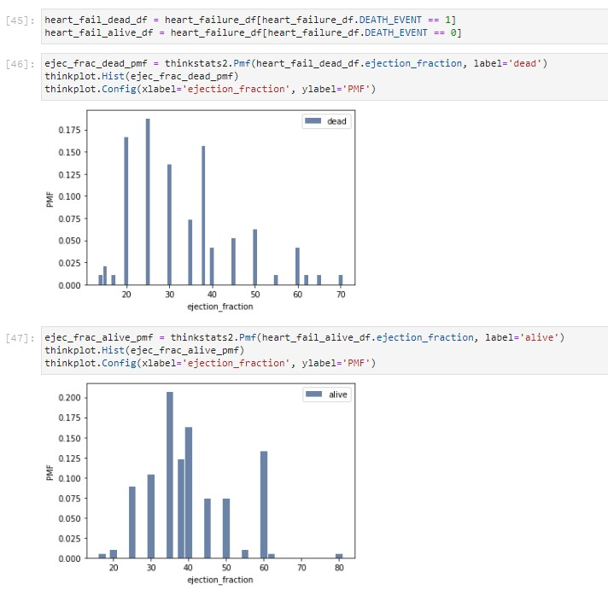
Comparison of Two Scenario
Using pg. 29 of your text as an example, compare two scenarios in your data using a PMF. Reminder, this isn’t
comparing two variables against each other – it is the same variable, but a different scenario. Almost like a filter. The example in the book is first babies compared to all other babies, it is still the same variable, but breaking the data out based on criteria we are exploring (Chapter 3).

Slide 14
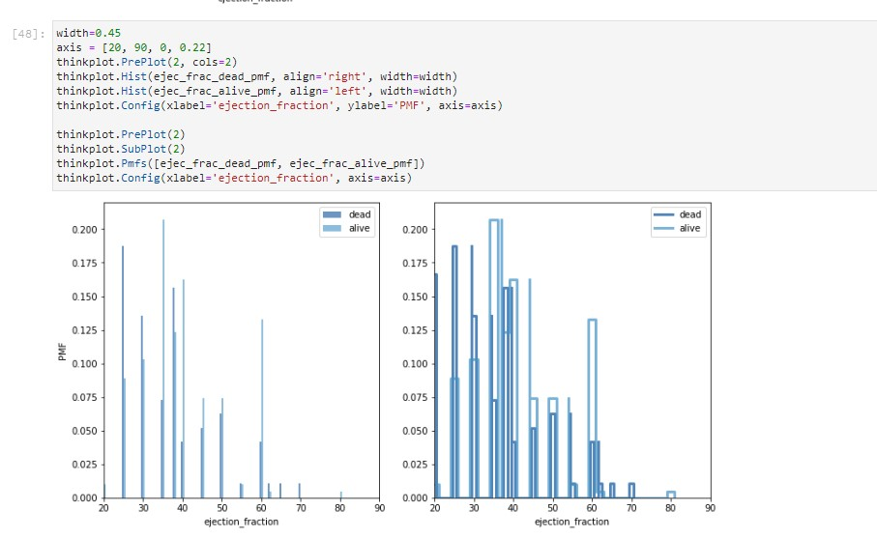
Comparison of Two Scenario - continued...
The comparison here is without any change in range and hence not very clear. I created another graph with adjusted ranges on next slide.

Slide 15
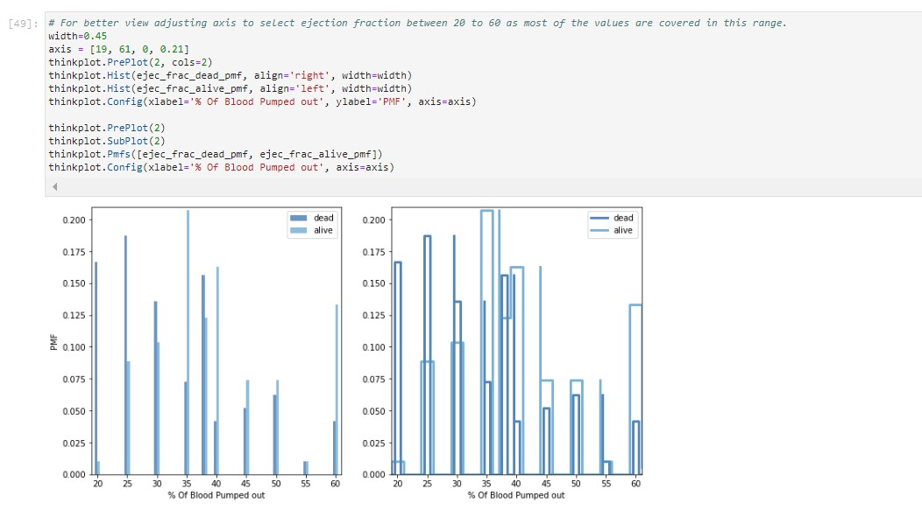
Comparison of Two Scenario - continued...
The comparison here considers ejection fraction greater than 20 and less than 61 (where mos of the data lies). We can see from the comparison PMF that for ejection fraction >= 40 has less deaths events.

Slide 16
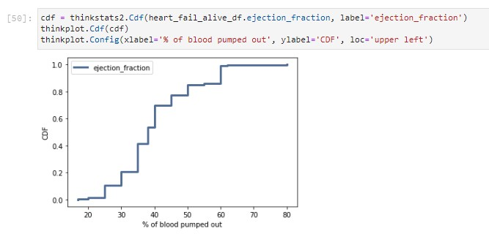
CDF
Create 1 CDF with one of your variables, using page 41-44 as your guide, what does this tell you about your variable and how does it address the question you are trying to answer (Chapter 4).
CDF ploted for ejection fraction shows distribution is approximately like step function. About 10% of data is having ejection fraction less than 25 and 90% of observations have ejection fraction < 60.

Slide 17
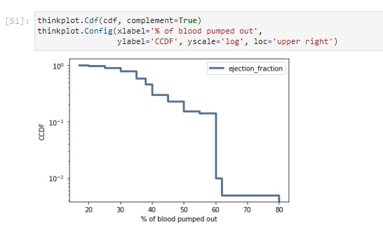
Analytical Distribution
Plot 1 analytical distribution and provide your analysis on how it applies to the dataset you have chosen (Chapter 5).
CCDF ploted for ejection fraction shows that the data is not normal. We will try other tests.

Slide 18
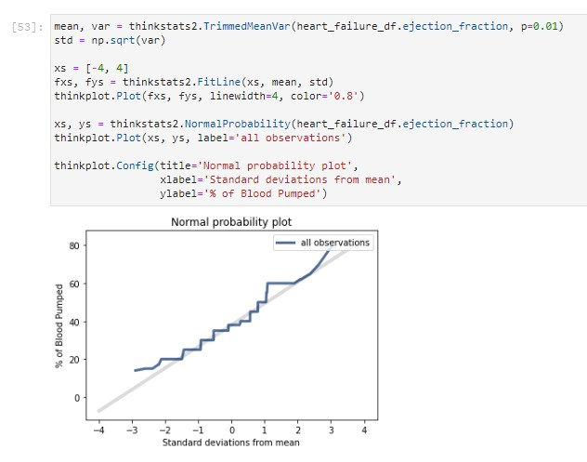
Analytical Distribution - continued...
Normal probability plot for ejection fraction shows that the data is approximately normal.

Slide 19
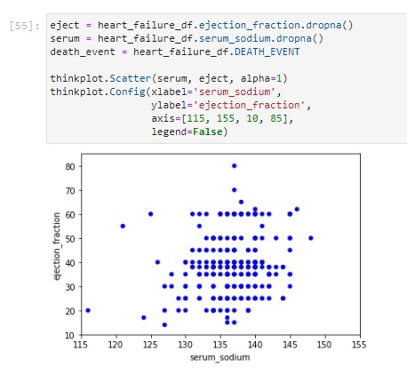
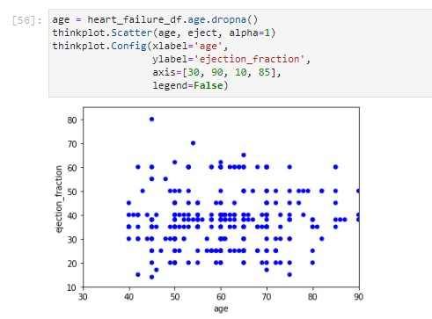
Scatter Plots
Create two scatter plots comparing two variables and provide your analysis on correlation and causation. Remember,
covariance, Pearson’s correlation, and Non-Linear Relationships should also be considered during your analysis (Chapter 7).
The scatter plot between Ejection fraction and Serum sodium shows that as serum sodium level increases there is decrease in ejection fraction. However its not very clear linear relation hence we will need to perform few more tests.
The scatter plot between ejection fraction and age shows as age increases there is reduction in rejection fraction. Again here as well the relationship is not linear.

Slide 20
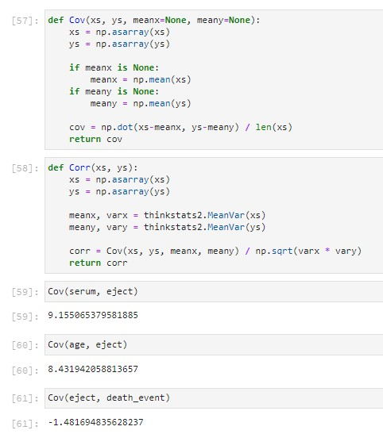
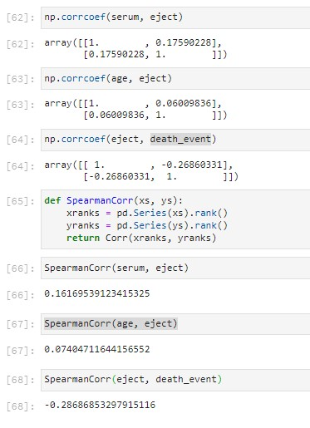
Scatter Plots - continued...
Covariance between ejection fraction and serum sodium is positive which means as serum sodium increases there is increase in ejection fraction. Similarly age and ejection fraction also has positive relation. For ejection fraction and death event the relationship is negative.
Correlation coefficient between ejection fraction and serum sodium is positive with value of 0.176 which means there is small effect of serum sodium increases on ejection fraction. For age and ejection fraction also there is positive relation with very less effect of 0.06. For ejection fraction and death event the relationship is negative with higher effect.
As seen in the scatter plot and correlation coefficients we don’t see there is strong relation. Hence verified non-linear relationship and we can see that Spearman’s correlation shows stronger relation between ejection fraction and death event that correlation coefficient.

Slide 21
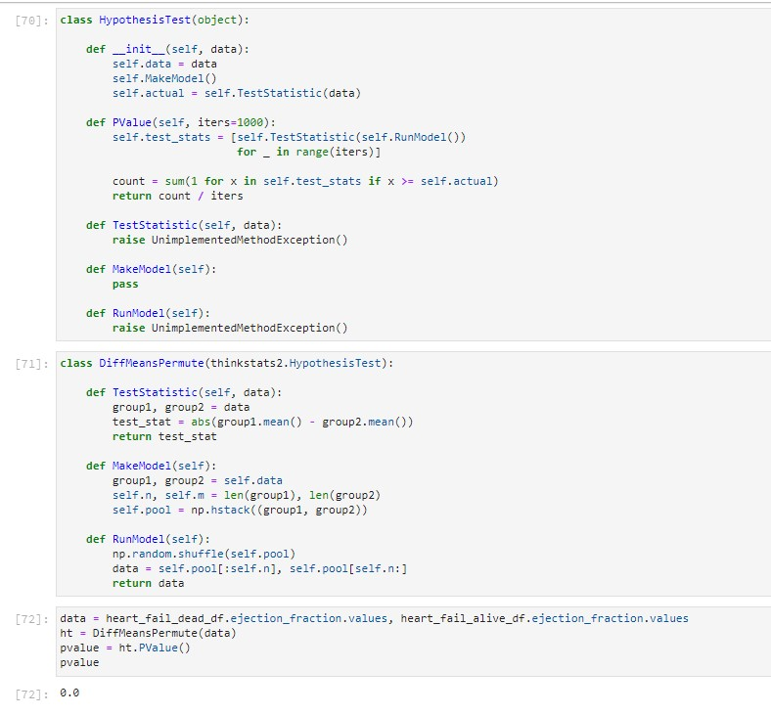
Hypothesis Test
Conduct a test on your hypothesis using one of the methods covered in Chapter 9.
The hypothesis test for ejection fraction shows that is has significant effect (p-value = 0).

Slide 22
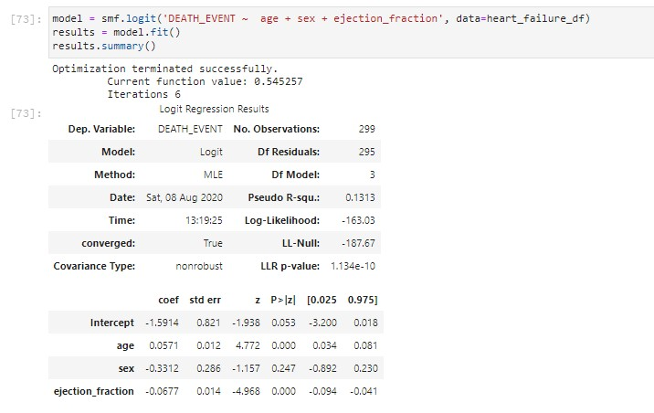
Regression Analysis
Conduct a regression analysis on either one dependent and one explanatory variable, or multiple explanatory variables (Chapter 10 & 11).
The regression above shows that the age and ejection_fraction variables are statistically significant because their p-values equal 0.000. On the other hand, Sex is not statistically significant because its p-value (0.247) is greater than the significance level of 0.05.

Slide 23
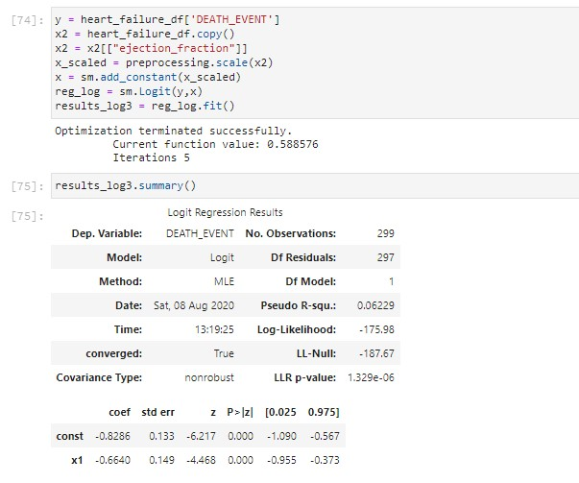
Regression Analysis - continued...
When plotted logistic regression for single variable "ejection fraction" it still shows the significance level - p-value of 0.000. Correlation coefficient of -0.664 shows negative relation which means if ejection fraction increases the chance of death decreases.

